Slide 1
Part 2: TTS – Text To Speech and Conversational AI Customization
Building Conversational AI Applications

Slide 2
Course Timeline
8:50 | — | 9:00 |  | Welcome
9:00 | — | 10:00 |  | Lecture 1
10:00 | — | 11:00 |  | Lab 1
11:00 | — | 11:15 |  | Break
11:15 | — | 12:15 |  | Lecture 2
12:15 | — | 13:15 |  | Lab 2
13:15 | — | 14:00 |  | break
14:00 | — | 15:00 |  | Lecture 3
15:00 | — | 16:00 |  | Lab 3
16:00 | — | 17:00 |  | Assessment support
Notes:
To change according to the agenda, time zone ..
Minimum 2 breaks per day. Minimum 30mn per lab
Minimum 30mn for assessment

Slide 3
Course Agenda
Part 1: ASR - Automatic Speech Recognition Lecture: Challenges of conversational AI applications, building blocks, ASR (automatic speech recognition) focus Lab: Investigate ASR pipeline with NeMo and Riva
Part 2: TTS – Text To Speech and Conversational AI Customization Lecture: How can we take advantage of conversational AI platforms to build custom applications? Lab: Investigate the TTS pipeline with NeMo and Riva; then build a full custom conversational AI pipeline.
Part 3: Production Deployment Lecture: Discussion of production deployment considerations including an overview of NVIDIA Triton Inference Server and TensorRT. Lab: Hands-on deployment of an example application using Helm and Kubernetes; includes profiling the application.

Slide 4
Part 2
TTS and Conversational AI Customization (Part 2)
Part1: Lecture
Speech Synthesis
TTS Tools: Riva, NGC, and NeMo
Lab overview
Part 1: Lab
Investigate TTS Pipeline with NeMo and Riva
Part 2: Lecture
Natural Language Understanding
NLU Tools: Riva, NGC, and NeMo
Dialog Manager
Lab overview
Part 2: Lab
ASR, TTS and NLP Customization

Slide 5



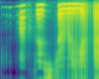
TTS Pipeline
Text Normalization & Pre-processing
Spectrogram Generator
Vocoder Model
Denoiser
Text
Speech
Input: Raw text
Output: Normalized and phonetized
…
Input: Phonemes, Pitch, Duration
Output: Spectrogram
Input: Spectrogram
Output: Audio
Input: Audio
Output: Audio

Slide 6
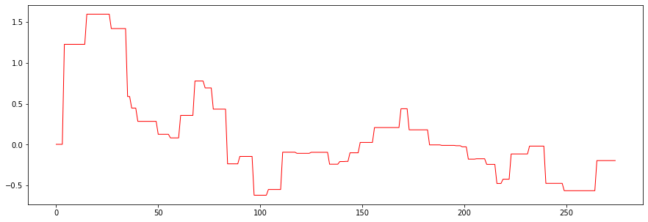
TTS Pipeline
Expressiveness | Multi-Speakers | Style Transfer
Input: Phonemes
Output: Pitch, Duration
Pitch and Duration Predictor
Text Normalization & Pre-processing
Spectrogram Generator
Vocoder Model
Denoiser
Text
Speech
Input: Raw text
Output: Normalized and phonetized
…
Input: Phonemes, Pitch, Duration
Output: Spectrogram
Input: Spectrogram
Output: Audio
Input: Audio
Output: Audio
Notes:
Today, accurate models are conditioned by a pitch and duration predictor.

Slide 7
TTS Pipeline
Expressiveness | Multi-Speakers | Style Transfer
Input: Spectrograms, speaker ID
Output: Speaker Embedding
Input: Phonemes
Output: Pitch, Duration
Speaker Embedding
Predictor
Pitch and Duration Predictor
Text Normalization & Pre-processing
Spectrogram Generator
Vocoder Model
Denoiser
Text
Speech
Input: Raw text
Output: Normalized and phonetized
…
Input: Phonemes, Pitch, Duration
Output: Spectrogram
Input: Spectrogram
Output: Audio
Input: Audio
Output: Audio

Slide 8
TTS Pipeline
Expressiveness | Multi-Speakers | Style Transfer
Input: Text, Spectrograms, Speaker embedding
Output: Latent-z parametrized by a distribution (Gaussian)
Input: Spectrograms, speaker ID
Output: Speaker Embedding
Input: Phonemes
Output: Pitch, Duration
Speech Characteristics Predictor
Speaker Embedding
Predictor
Pitch and Duration Predictor
Text Normalization & Pre-processing
Spectrogram Generator
Vocoder Model
Denoiser
Text
Speech
Input: Raw text
Output: Normalized and phonetized
…
Input: Phonemes, Pitch, Duration
Output: Spectrogram
Input: Spectrogram
Output: Audio
Input: Audio
Output: Audio

Slide 9
TTS Evaluation Metric

Slide 10
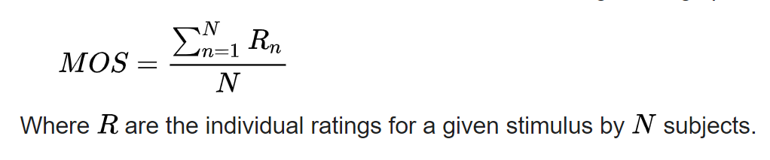
Measuring Success of Speech Synthesis
Mean opinion score
It is the arithmetic mean over all individual "values on a predefined scale that a subject assigns to his opinion of the performance of a system quality".
Rating | Label
5 | Excellent
4 | Good
3 | Fair
2 | Poor
1 | Bad

Slide 11
Spectrogram Generator

Slide 12
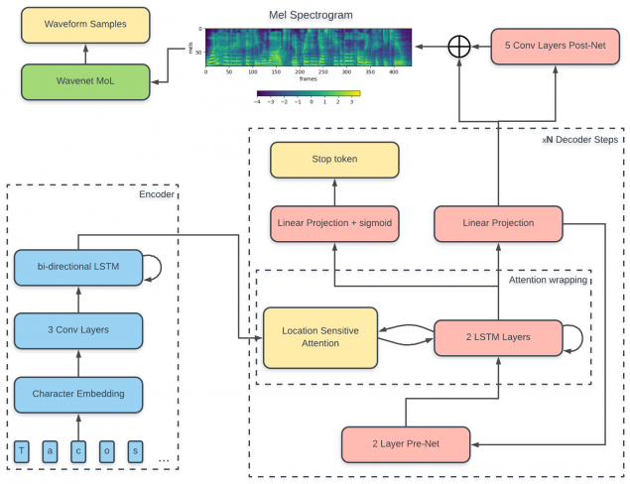
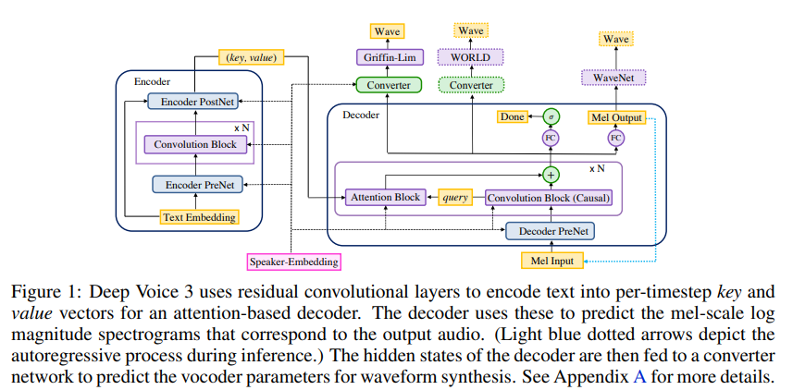
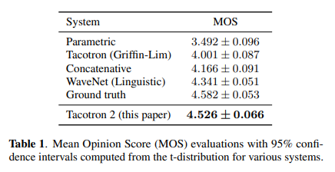
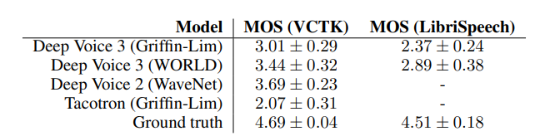
Spectrogram Generator
Deep Voice 3, Tacotron, Tacotron 2 | Autoregressive Models
Jonathan Shen et al. TTS Synthesis by Conditioning WaveNet on Mel Spectrogram Predictions. 2018
Wei Ping et al, DEEP VOICE 3: SCALING TEXT-TO-SPEECH WITH CONVOLUTIONAL SEQUENCE LEARNING. ICLR 2018
Notes:
Seq2seq models generating specs from text input
deep voice 3:
- input: speaker embedding + text embedding generates mel spectrograms
- evaluated wth wavenet, world and griffin-Lim
Tacotron: Encoder-decoder
- Encoder based on character embeddings + 3 conv + bi-diectionlal lstm
- Then, the decoder: attention +LSTM
Problems:
- Autoregressive are slow
- Big problems of repetition and skipping words

Slide 13
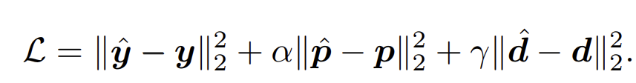
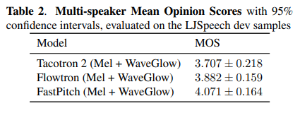
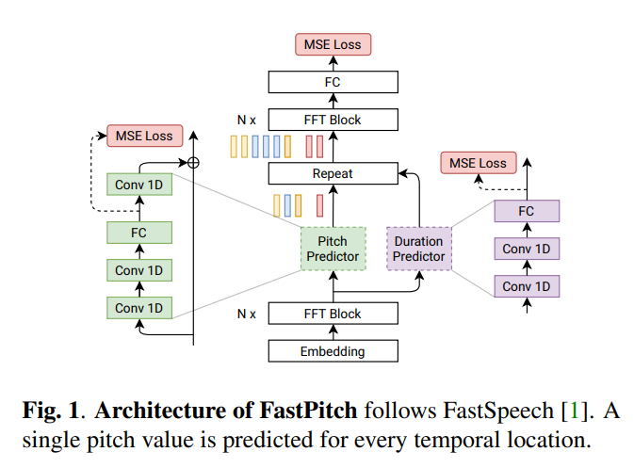
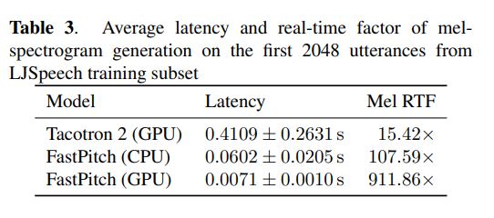
Spectrogram Generator
FASTSPEECH, FastPitch – Condition to duration and pitch | Parallel TTS
FastPitch:
Train Pitch, duration and spectrograms predictors.
Ground truth p and d are used during training,
Loss mean-squared error (MSE) between the predicted spectrogram, pitch and duration
Listen to samples:
Fastspeech2: https://speechresearch.github.io/fastspeech2/
FastPitch: https://fastpitch.github.io/
Y. Ren, Y. Ruan, X. Tan, T. Qin, S. Zhao, Z. Zhao, and T.-Y. Liu, “Fastspeech: Fast, robust and controllable text to speech,” in NeurIPS 2019, 2019
Y. Ren, C. Hu, X. Tan, T. Qin, S. Zhao, Z. Zhao, and T.- Y. Liu, “Fastspeech 2: Fast and high-quality end-to-end text to speech,” arXiv:2006.0455, 2020.
Adrian Łancucki. FASTPITCH: PARALLEL TEXT-TO-SPEECH WITH PITCH PREDICTION. ICASSP2021
Notes:
Fastspeech and Fastpitch are Non autoregressive models which are conditioned by the Duration, Pitch.
Fastpitch
- FFT: feed forward transformer block with length conditions to be the text<>Speech alignment
- Fastpitch is based on a bunch of FFT: feed forward transformer a Pitch predictor and duration predictor

Slide 14
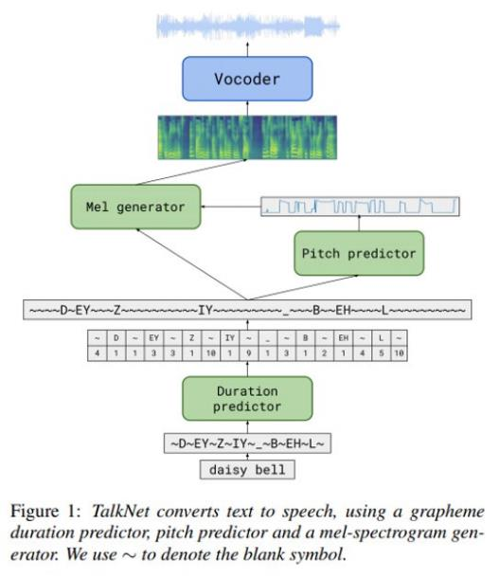
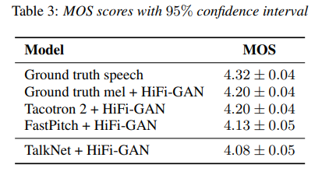
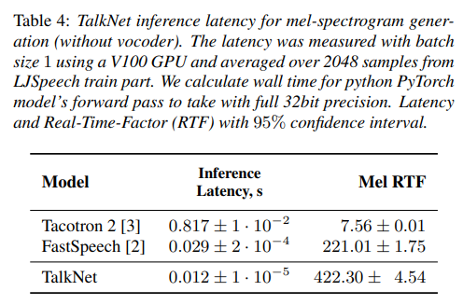
Spectrogram Generator
TalkNet - convolutional model | parallel TTS
13.2M parameters (almost 2x less than SOTA TTS)
Parallel TTS: fast training and inference – 422x times faster than real-time
The quality of the generated speech nearly matches the best auto-regressive models
Stanislav Beliaev and Boris Ginsburg. TalkNet 2: Non-Autoregressive Depth-Wise Separable Convolutional Model for Speech Synthesis with Explicit Pitch and Duration Prediction. 2021

Slide 15
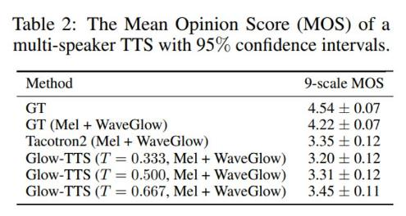
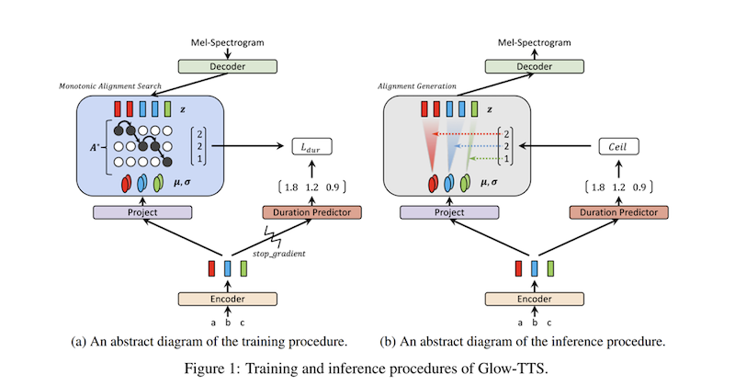
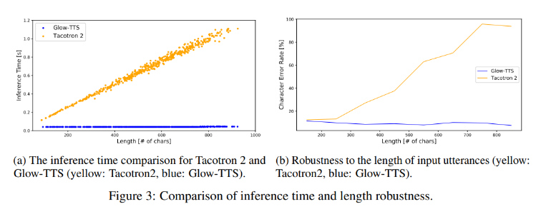
Spectrogram Generator
Glow TTS - Transformers | Parallel TTS
Monotonic Alignment Search
“Glow-TTS can generate mel-spectrograms 15.7 times faster than the autoregressive TTS model, Tacotron 2, while obtaining comparable performance.”
No external aligner, learn its own alignment using Monotonic Alignment Search
Listen to Glow-TTS samples: https://jaywalnut310.github.io/glow-tts-demo/index.html
Aehyeon Kim and Sungwon Kim and Jungil Kong and Sungroh Yoon. Glow-TTS: A Generative Flow for Text-to-Speech via Monotonic Alignment Search. 2020
Notes:
Glow-TTS Simplifies the training procedure of parallel TTS models using Monotonic Alignment Search:
That searches for the most probable alignment between latent representations of text and the of speech.
Encoder, decoder are transformer based
Monotonic Alignment Search differs
- from CTC Because it is generative with Mixture of gaussians,
- from HMMs Because it is parallel without the assumption of conditional independence over observations

Slide 16
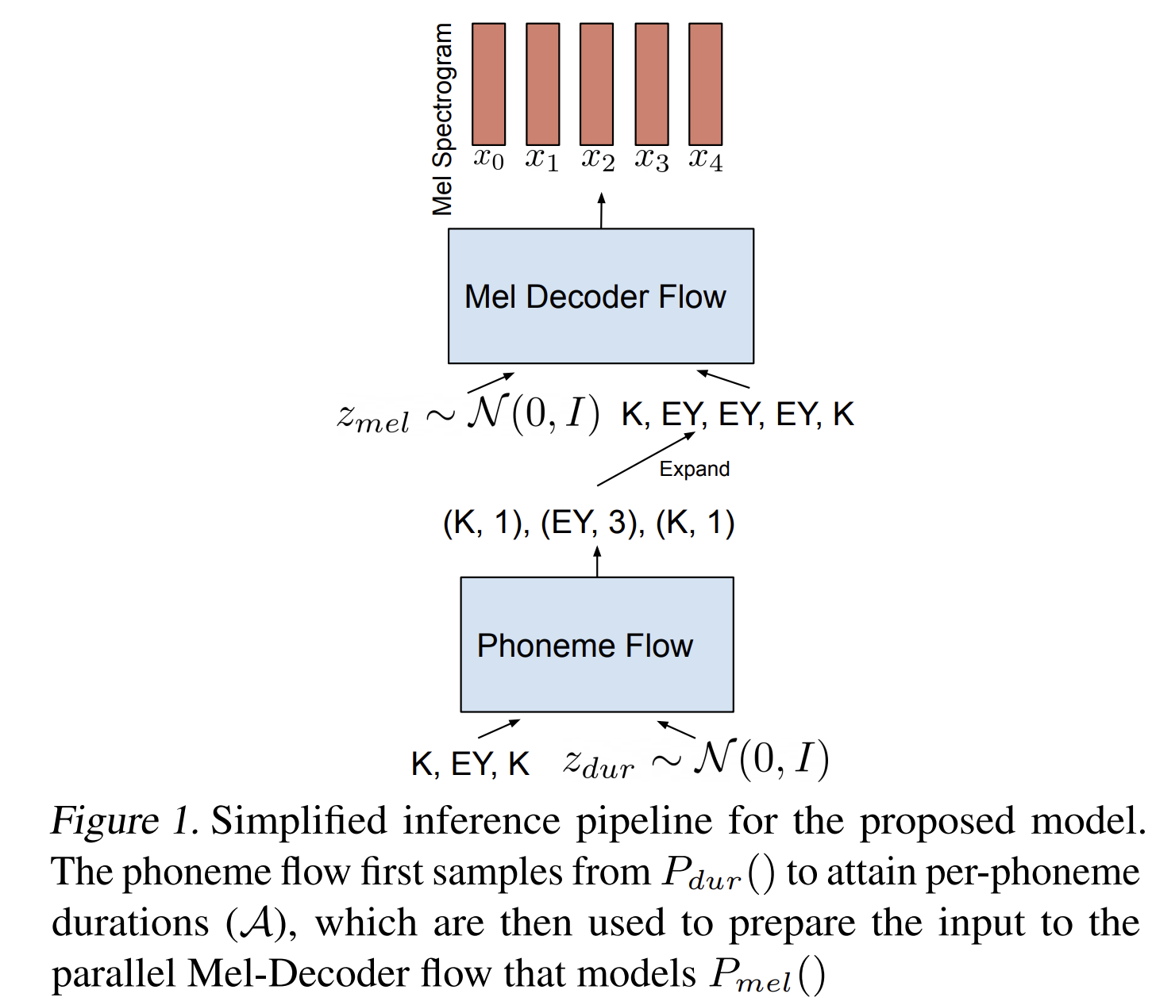
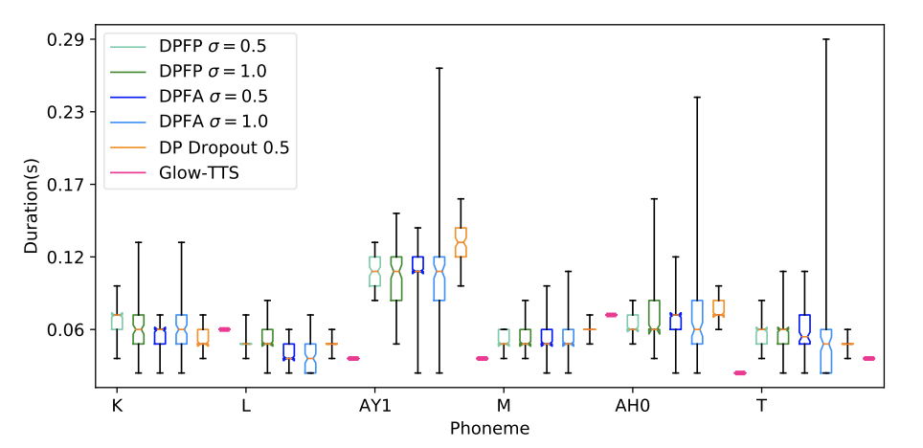
Spectrogram Generator
Diversity | RadTTS
Evaluation of RAD-TTS wrt other non-autoregressive models in terms of variability in speech.
https://nv-adlr.github.io/RADTTS
Notes:
RadTTS: generative speech features for further diversity
By making the phoneme and mel-decoder generative (using a gaussian distribution)
This allows to control the amount of prosodic variation in speech for the duration generative model.

Slide 17
Spectrogram Generator
Multi-Speakers TTS | Spectrogram Generator conditioned to Speaker
Speaker Embedding
Pitch and Duration Predictor
Text Normalization & Pre-processing
Spectrogram Generator
Vocoder Model
Denoiser
Text
Speech
Notes:
Ok, How about Multiple voices in a single model?

Slide 18
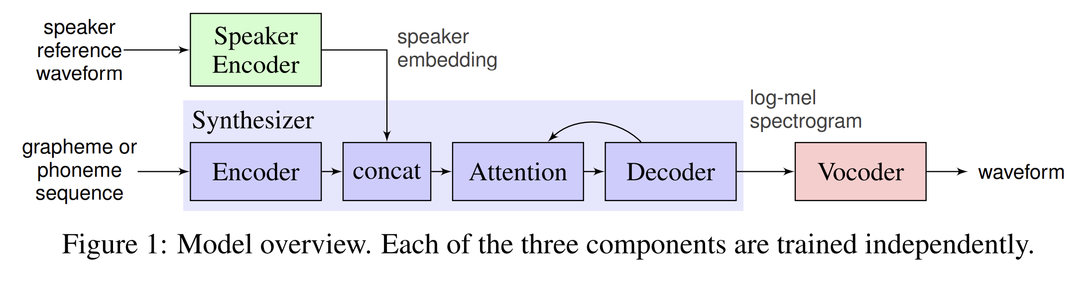
Spectrogram Generator
Multi-Speakers TTS | Spectrogram Generator conditioned to Speaker
Speaker encoder, Spectrogram Generator and Vocoders are trained independently
Speaker Encoder:
Input: Spectrograms
Network: Stack of 3 LSTM layers, each followed by a projection to 256 dimensions
Output: Averaged and normalized embedding on sliding window
Trained for text-independent speaker verification task.
Wavnet
Tacotron2
Ye Jia∗ Yu Zhang∗ Ron J. Weiss∗ Quan Wang Jonathan Shen Fei Ren, Zhifeng Chen Patrick Nguyen Ruoming Pang Ignacio Lopez Moreno Yonghui WuTransfer Learning from Speaker Verification toMultispeaker Text-To-Speech Synthesis. 2019
Notes:
multi-speaker TTS (Google)
Architecture: Speaker encoder, Spectrogram Generator (tacotron2) and Vocoders (wavnet). All 3 are trained independently
For the Speaker Encoder:
Input: Spectrograms
Network: Stack of 3 LSTM layers, each followed by a projection to 256 dimensions
Output: Averaged and normalized embedding on sliding window
Trained for text-independent speaker verification task.

Slide 19
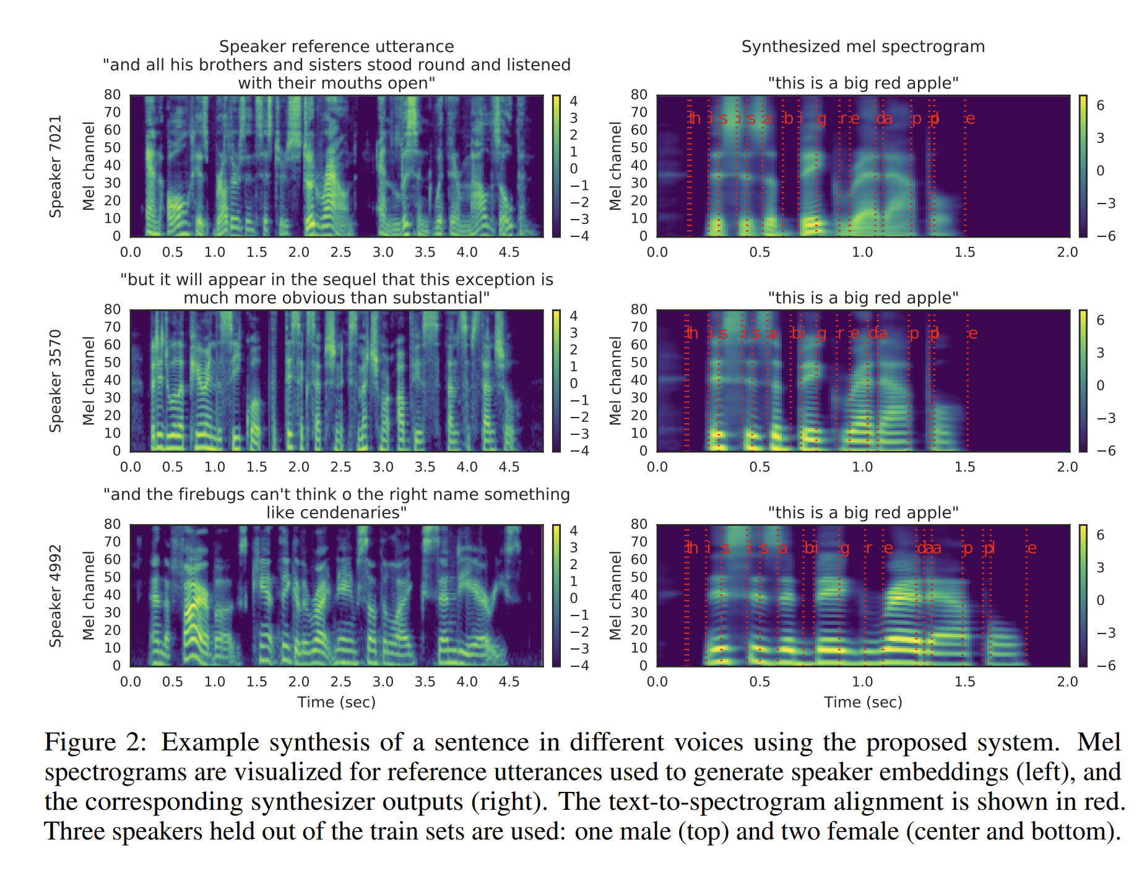
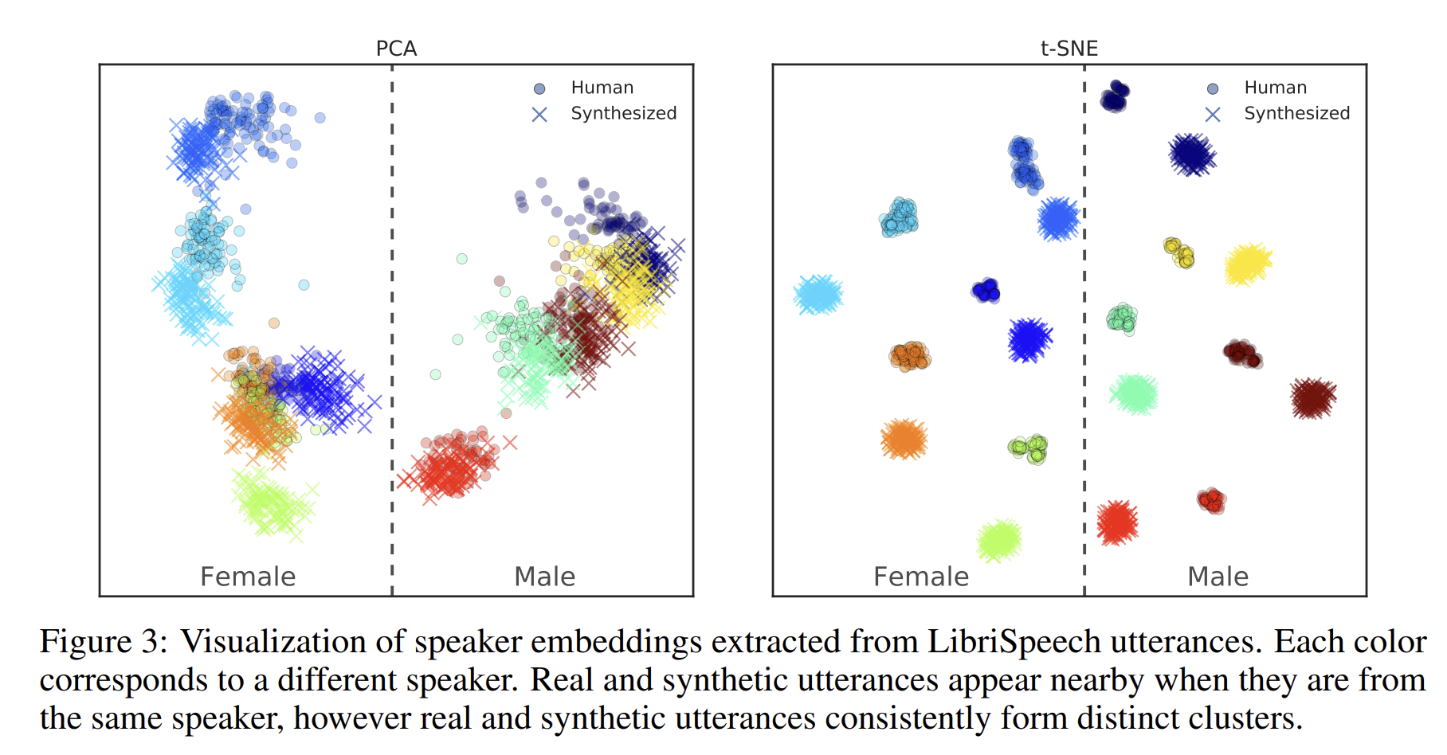
Spectrogram Generator
Multi-Speakers TTS | Spectrogram Generator conditioned to Speaker
Ye Jia∗ Yu Zhang∗ Ron J. Weiss∗ Quan Wang Jonathan Shen Fei Ren, Zhifeng Chen Patrick Nguyen Ruoming Pang Ignacio Lopez Moreno Yonghui WuTransfer Learning from Speaker Verification toMultispeaker Text-To-Speech Synthesis. 2019

Slide 20
Spectrogram Generator
Style Transfer | Spectrogram Generator conditioned to a style
Speech Characteristics
Speaker Embedding
Pitch and Duration Predictor
Text Normalization & Pre-processing
Spectrogram Generator
Vocoder Model
Denoiser
Text
Speech
Notes:
We can adds a Speech Characteristics descriptor in order to condition the TTS to a specific stye of speech

Slide 21
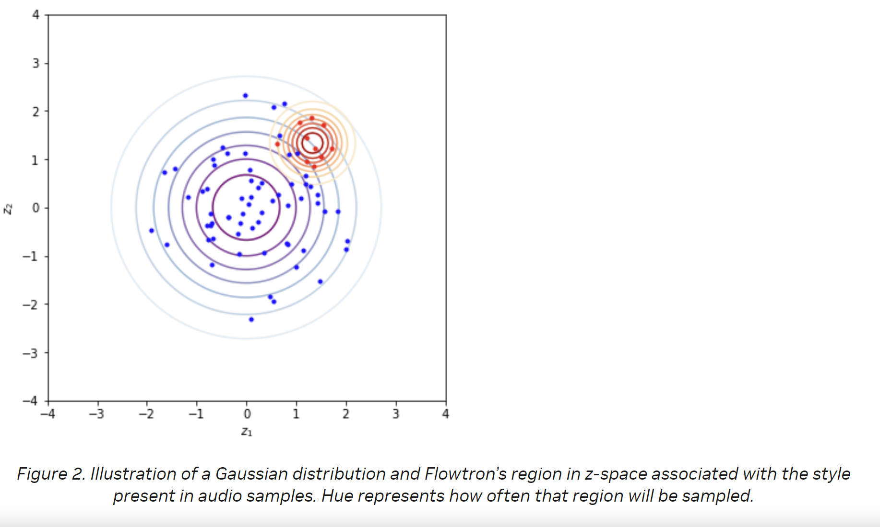

Spectrogram Generator
Style Transfer | FlowTron
Speech characteristics: Maps a distribution over mel spectrograms and text to a latent z-space parametrized by a simple distribution (Gaussian).
Flowtron can transfer the style from data or speakers not seen in the training
At inference: Either sample from all speaking styles or sample from specific speaking styles.
Provide audio samples to find the region in z-space that is associated with its specific speaking style (red dots)
Compute their centroid
Use this centroid as the mean of a Gaussian distribution (red circles) and adjust the variance one more time to adjust the span of the region in the z-space being sampled
.
Baseline (sally)
Style (surprised)
Target (Sally sounds surprised)
Rafael Valle, Kevin Shih, Ryan Prenger, Bryan Catanzaro. Flowtron: an Autoregressive Flow-based Generative Network for Text-to-Speech Synthesis. 2020
Notes:
Flowtron: Speech characteristics that projects the distribution over mel-spectrogram and text to a latent z-space of speech style that is a gaussian distribution
At inference, Either sample from all speaking styles or sample from specific speaking styles.

Slide 22
Audio Generation (Vocoder)

Slide 23
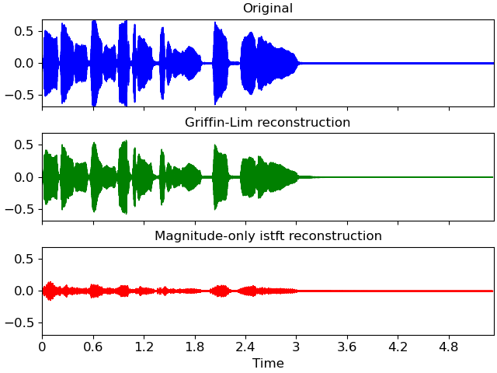
Vocoder
Griffin-Lim Algorithm
Why not use Inverse Fourier Transform to get back to the temporal domain (wave format) from the synthesized spectrograms?
With the spectrograms we have the amplitude, but we lost the phase
Griffin-Lim algorithm:
Given a Short-Time Fourier Transform magnitude matrix (S), the algorithm randomly initializes phase estimates, and then alternates forward- and inverse-STFT operations until satisfying result
https://librosa.org/doc/main/generated/librosa.griffinlim.html
Notes:
inverse-STFT by default uses Griffin-Lim algorithm to reconstruct the signal

Slide 24
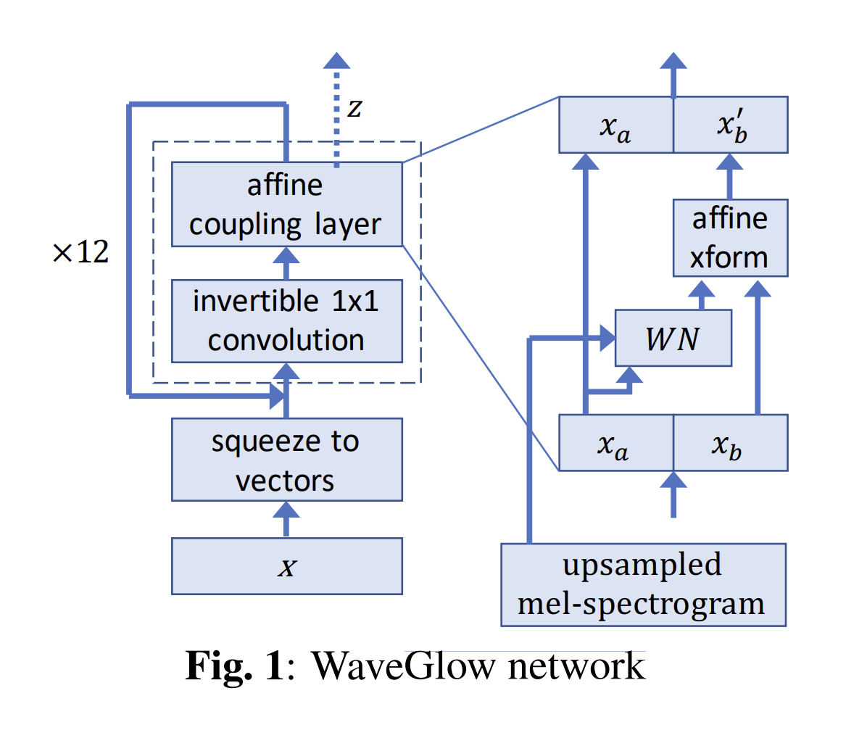
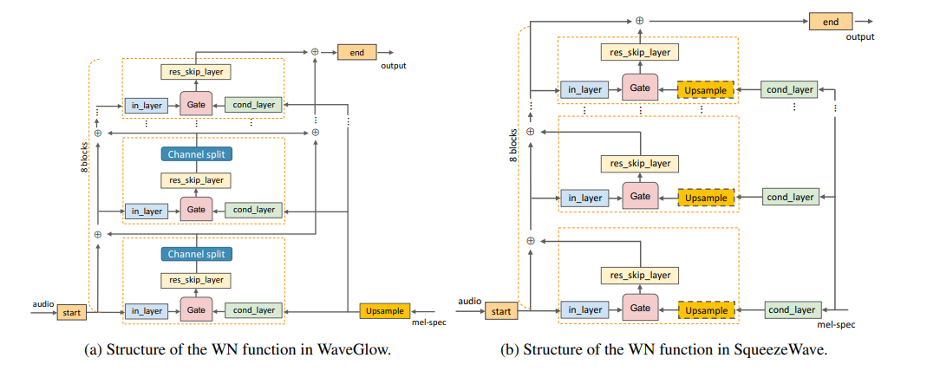
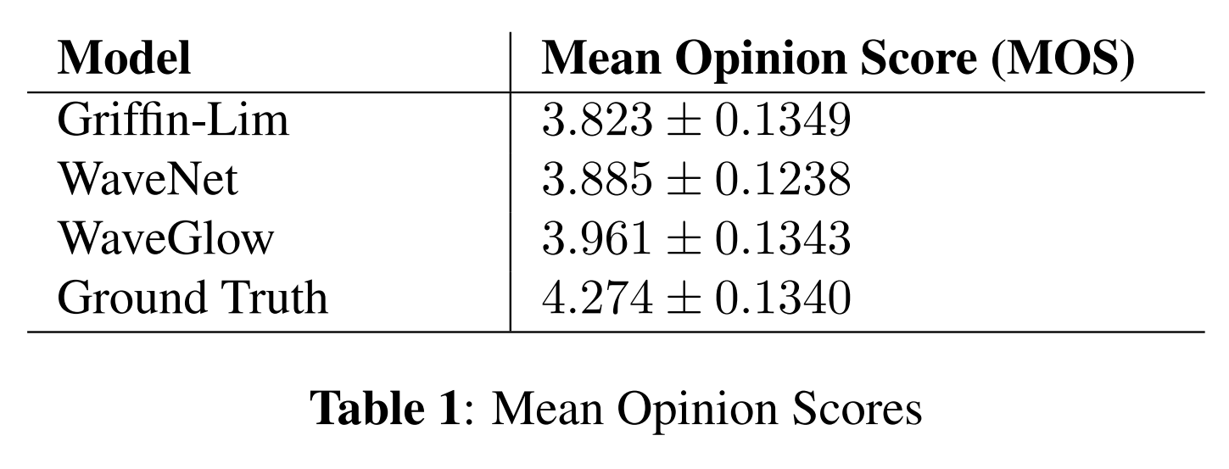
WaveGlow, SqueezeWave
A Non autoregression combination of WaveNet + Glow
Prenger, R., Valle, R., & Catanzaro, B. (2019, May). Waveglow: A flow-based generative network for speech synthesis. In ICASSP 2019-2019 IEEE International Conference on Acoustics, Speech and Signal Processing (ICASSP) (pp. 3617-3621). IEEE.
Bohan Zhai and Tianren Gao and Flora Xue and Daniel Rothchild and Bichen Wu and Joseph E. Gonzalez and Kurt Keutzer. SqueezeWave: Extremely Lightweight Vocoders for On-device Speech Synthesis. 2020

Slide 25
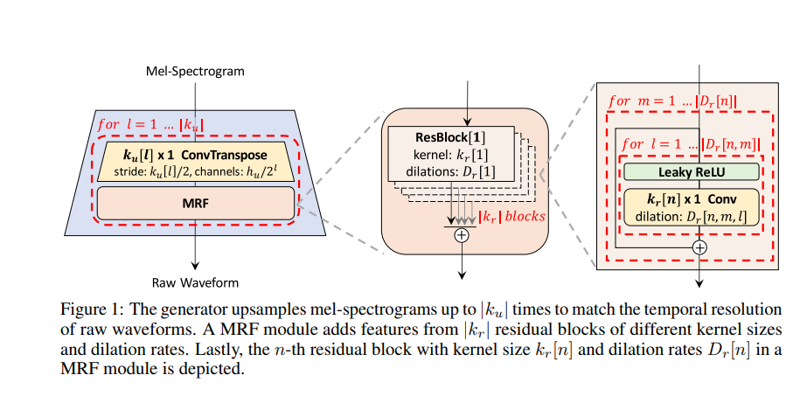
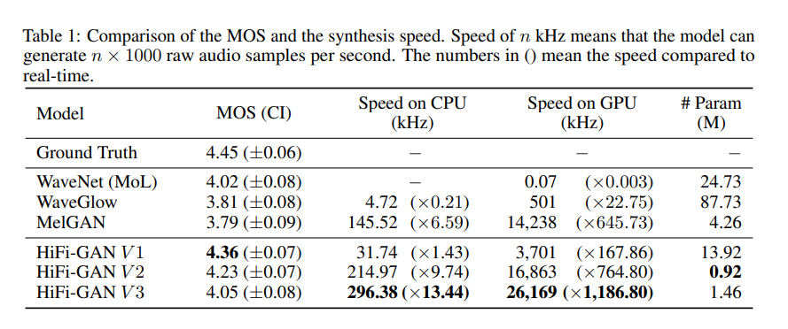
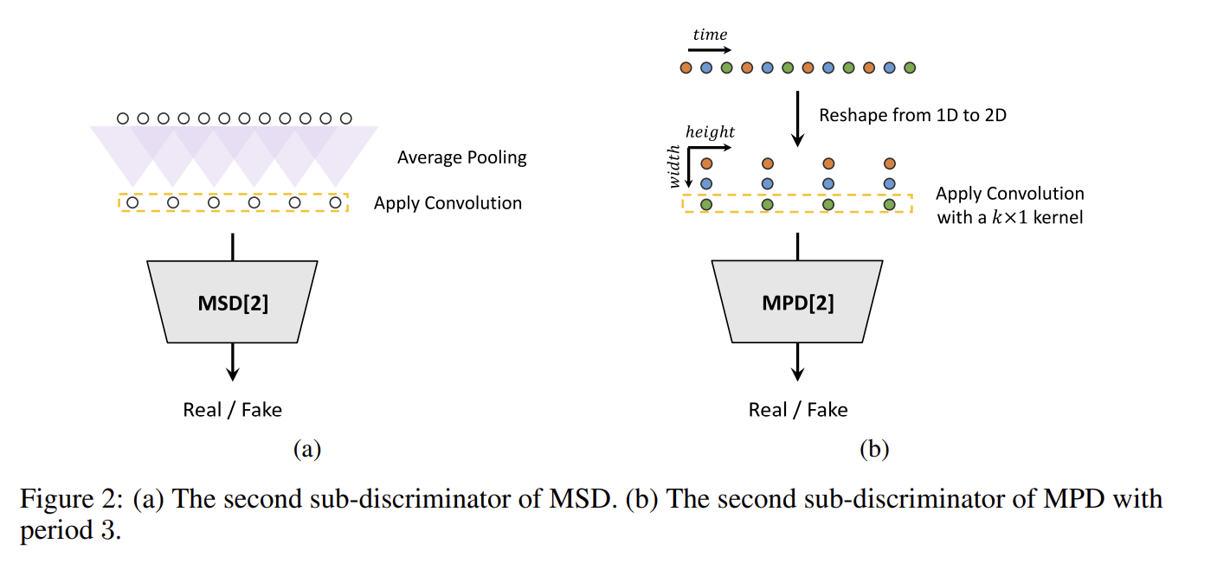
HiFiGan
Matching performance of autoregressive models
Generator
Discriminators
Jungil Kong and Jaehyeon Kim and Jaekyoung Bae. HiFi-GAN: Generative Adversarial Networks for Efficient and High Fidelity Speech Synthesis. 2020
Notes:
HiFi-GAN consists of: one generator and two discriminators: MSD for multi-scale and MPD for multi-period discriminators.

Slide 26
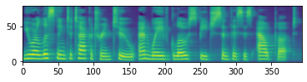
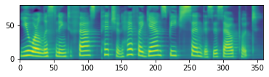
Text-To-Speech (TTS)
Deep learning based models
You are listening to Tacotron two and wave glow speech synthesis output
You are listening to Fast Pitch and Hifi GAN speech synthesis output
Try it: https://github.com/NVIDIA/NeMo/tutorials/tts/Inference_ModelSelect.ipynb

Slide 27
End-to-End Speech Synthesis

Slide 28
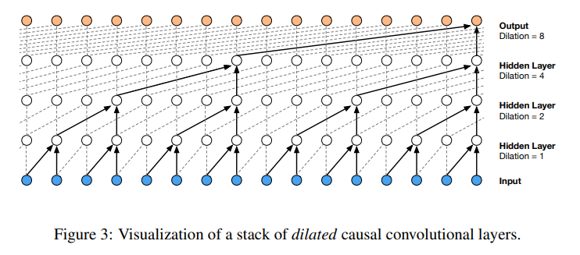
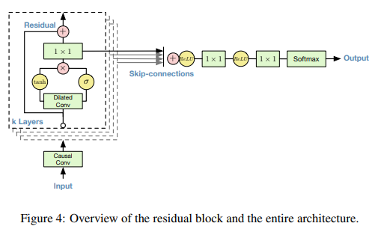
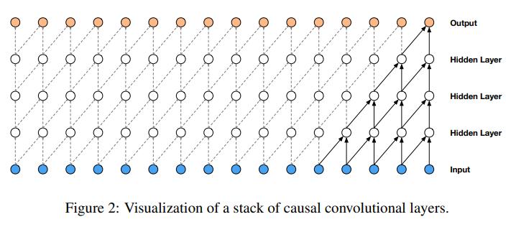
End-to-End Synthesis
WaveNet - autoregressive
Apply over an area larger than its length by skipping input values with a certain step
Predictions at timesteps t cannot depend on the future timesteps
Oord, A. V. D., Dieleman, S., Zen, H., Simonyan, K., Vinyals, O., Graves, A., ... & Kavukcuoglu, K. (2016). Wavenet: A generative model for raw audio. arXiv preprint arXiv:1609.03499.
Notes:
Google WaveNet is an audio generative model based on dilated Convolutions

Slide 29
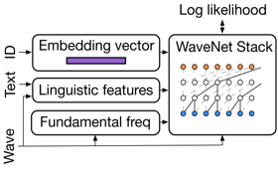
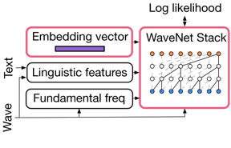
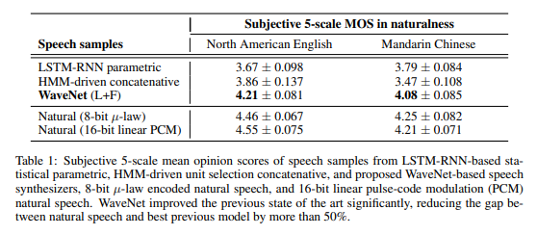
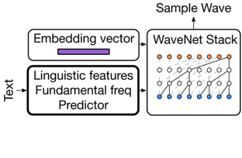
End-to-End Synthesis
WaveNet - autoregressive
Training
Slow, lots of data
Adaptation
Fast, few data, pink boxes are fine-tuned
Inference
Oord, A. V. D., Dieleman, S., Zen, H., Simonyan, K., Vinyals, O., Graves, A., ... & Kavukcuoglu, K. (2016). Wavenet: A generative model for raw audio. arXiv preprint arXiv:1609.03499.

Slide 30
TTS Models
Recap
 | Tasks | Approach
DeepVoice 3 | Spectrogram Generator | Convolutional | Autoregressive
Tacotron /Tacotron 2 | Spectrogram Generator | Convolutional + LSTM | Autoregressive
FastSpeech | Spectrogram Generator | Transformer + Convolutional Condition to Duration and Pitch | Non Autoregressive
FastPitch | Spectrogram Generator | Transformer + Convolutional Condition to Duration and Pitch | Non Autoregressive
TalkNet | Spectrogram Generator | Convolutional Condition to Duration and Pitch | Non Autoregressive
Glow TTS | Spectrogram Generator | Transformer + Convolutional Condition to Duration and Pitch | Non Autoregressive
RadTTS | Spectrogram Generator | Generative modelling of durations to add diversity | Non Autoregressive
Flowtron | Spectrogram Generator | Modified Tacotron2 Condition to Speaker Embeddings and Speech Style | Autoregressive
WaveGLow | Vocoder | Affine Coupling Layer + Convolutional | Non Autoregressive
SqueezeWave | Vocoder | Affine Coupling Layer + Convolutional | Non Autoregressive
HifiGAN | Vocoder | Convolutional + MRF Adversarial Training: 1 Generator and 2 discriminators | Non Autoregressive
Wavenet | End-to-End synthesis | Dilated Convolutions Linguistic conditioning, F0 and duration | Autoregressive
Notes:
Let’s recap

Slide 31
Part 2
TTS and Conversational AI Customization (Part 2)
Part1: Lecture
Speech Synthesis
TTS Tools: Riva, NGC, and NeMo
Lab overview
Part 1: Lab
Investigate TTS Pipeline with NeMo and Riva
Part 2: Lecture
Natural Language Understanding
NLU Tools: Riva, NGC, and NeMo
Dialog Manager
Lab overview
Part 2: Lab
ASR, TTS and NLP Customization

Slide 32
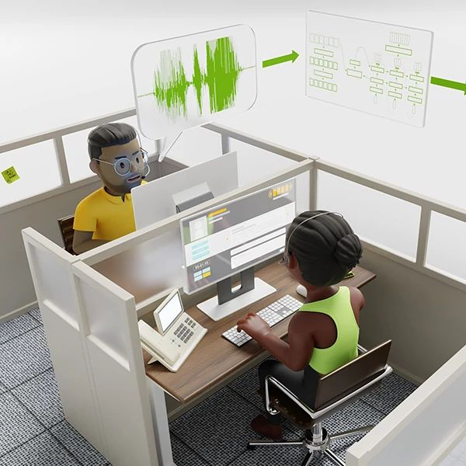
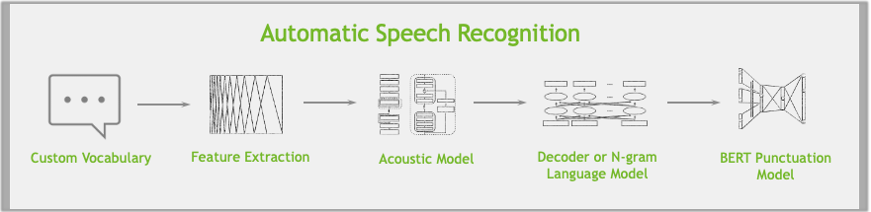
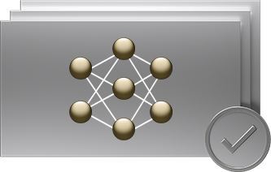
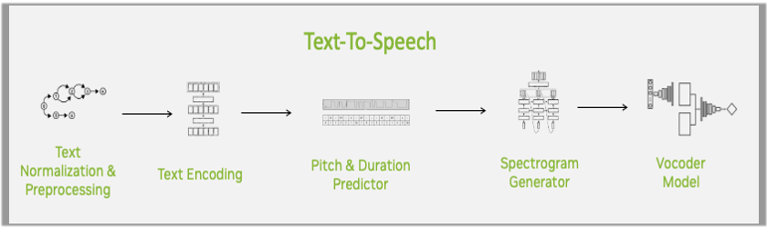
NVIDIA Riva
Fully customizable, GPU-Accelerated SDK for real-time Speech AI
NGC
Out-Of-The-Box
RIVA SKILLS: ASR & TTS
Accurate Transcriptions
RETRAIN
Refine Model
Build Your Own Model
Domain Specific
Speech
SOTA Pre-Trained Models
Train for Any
Domain and Language
Fully Customizable for the Best Possible Accuracy
GPU-Accelerated, Real-Time
Scale to Hundreds of Thousands of Users
On-Prem, in Any Cloud, at the Edge, or Embedded
SOTA – State-Of-The-Art | ASR – Automatic Speech Recognition | TTS – Text-To-Speech

Slide 33


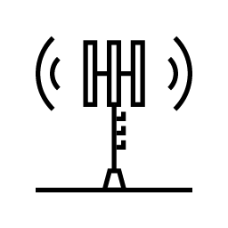







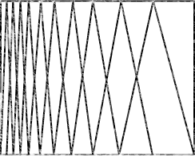
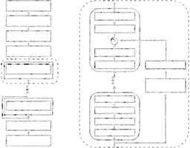
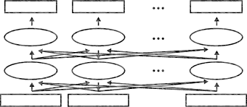
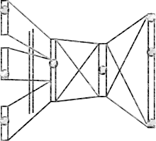
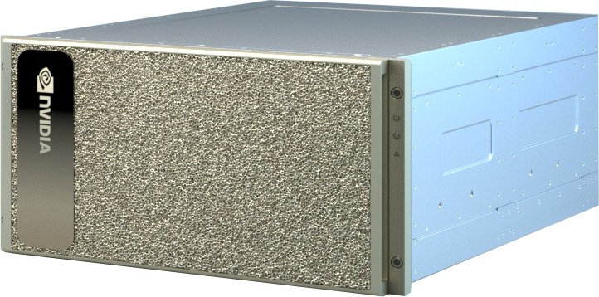
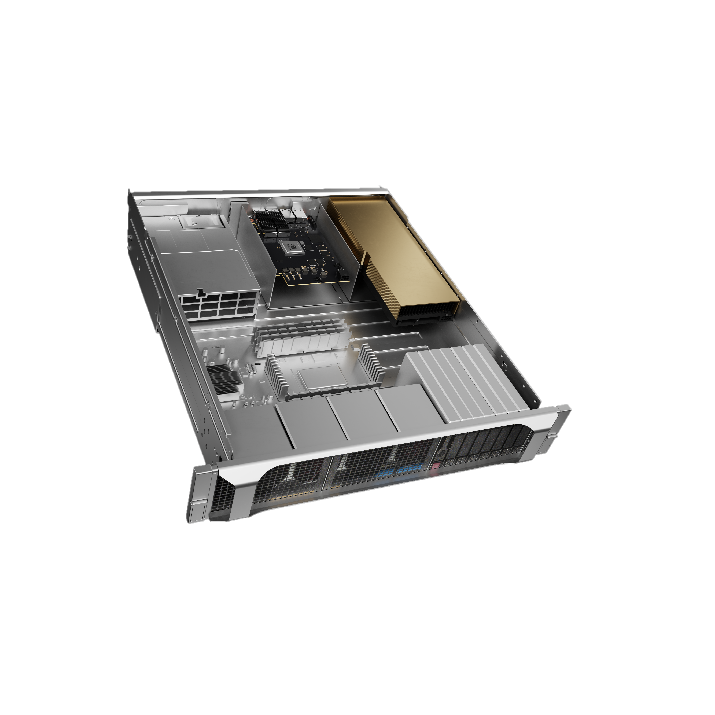




NVIDIA Riva Text-To-Speech
World-Class TTS with SOTA Deep Learning
Applications
Contact Centers
Consumer Applications
Video Conferencing
SOTA OOTB expressive voice models
Female & male OOTB professional voices for English
Easy voice control at inference time with SSML API for:
Pronunciation
Pitch
Volume
Pause
12X higher inference performance versus existing technologies.
CRISP / Service Provider
Media & Entertainment
Transportation
Healthcare
Energy
Finance
Retail
Education
Telecom
RIVA TTS
Triton
TensorRT
All Clouds, On-Premises, Edge, & Embedded
Systems
Cloud
NVIDIA DGX
NVIDIA EGX
TTS – Text-To-Speech | SOTA – State-Of-The-Art | OOTB – Out-Of-The-Box | SSML – Speech Synthesis Markup Language

Slide 34

NVIDIA Riva Delivers World-Class TTS
HIGH-QUALITY TTS VOICES
US English Female
US English Male
TTS – Text-To-Speech | SOTA – State-Of-The-Art | RTFX – Inverse of Real Time Factor (RTF) = $\frac{compute time [sec]}{audio inferred [sec]}$

Slide 35






Achieving Human-Like Voice and Intonation for Real-World TTS Apps Is Challenging
Sounding natural, emotion expressivity, compute intensive pipeline robustness
TEXT-TO-SPEECH
“Expect some clear skies in London tomorrow.”
“Expect some clear skies in London tomorrow.”
Text
Audio
Text Normalization & Preprocessing
Text Encoding
Pitch and Duration Predictor
Spectrogram Generator
Vocoder Model

Slide 36
Customizations Across Riva TTS Pipeline
Controllability, expressiveness, high-performance
SSML
RIVA TTS PIPELINE
Text
Speech
Text Encoding
Pitch and Duration Predictor
Spectrogram Generator
Vocoder Model
Text Normalization
Fine-Tuning
"at 10:00“ => "at ten o'clock”
Inverse Text Normalization
Fine-Tuning
“at ten o'clock" => "at 10:00“
Fine-Tuning
Customization during:
Training (server-side) – Need to rebuild/restart server
Inference (client-side) – No need to rebuild/start Riva server
TTS – Text-To-Speech | SSML – Speech Synthesis Markup Language
Notes:
Models: Tacotron 2, WaveGlow, FastPitch and HiFiGAN​
Customizations:​
Spectrogram Generator Model​
Speech Elements (Pitch & Duration) at Inference Time​
Streaming Mode | Batch Mode

Slide 37

What is NeMo?
Toolkit to build state-of-the-art conversational AI models
DL-Based Speech & Language Understanding Models
Include Semantic Checking for Correct-by-Construction Architectures
Open-Sourced
Integrated with PyTorch & PyTorch Lightning
Easy-to-Use APIs
Optimized Training Performance
100+ Pre-Trained GPU-Optimized Checkpoints
Scale to 1000s of NVIDIA GPUs
https://ngc.nvidia.com/catalog/containers/nvidia:nemo
https://github.com/NVIDIA/NeMo
Notes:
NeMo for Neural Module is an open source Toolkit aiming to simplify building CAI with SOTA DL based models.
Nemo has several features allowing to hide the complexity of such pipelines.
It divides the network into essential components such as the dataLoader, encoder, decoder simplifying experimentation to find the best architecture.
Nemo is built on top of Pytorch and integrates PyTorch Lightning for easy calls to multi-GPU and multi-node training.
It is highly optimized for training with NVIDIA GPUs using AMP and distributed training
With Nemo, we can train and finetune models for ASR, NLU and TTS
Next please

Slide 38


Deploy to Production
Generate high-performance inference
Quickly export NeMo models to Riva
Support for speech and language models across multiple languages
Step-by-step deployment instructions in documentation
NeMo Model
Riva
NeMo2Riva Export Tool
Exporting NeMo Models to Riva

Slide 39
Part 2
TTS and Conversational AI Customization (Part 2)
Part1: Lecture
Speech Synthesis
TTS Tools: Riva, NGC, and NeMo
Lab overview
Part 1: Lab
Investigate TTS Pipeline with NeMo and Riva
Part 2: Lecture
Natural Language Understanding
NLU Tools: Riva, NGC, and NeMo
Dialog Manager
Lab overview
Part 2: Lab
ASR, TTS and NLP Customization

Slide 40

The Goal of the Lab
Beyond OOTB models
Investigate AI models for Speech Synthesis
Normalize written text to speech-appropriate text and convert graphemes to phonemes
Use the Fastpitch model to create a spectrograph
Convert spectrograms to audio with the HifiGan vocoder model and Customize speech output
TTS deployment with Riva
Launch Riva TTS service
Request the TTS service using a Python client API
Customize pronunciations

Slide 41
Part 2
TTS and Conversational AI Customization (Part 2)
Part1: Lecture
Speech Synthesis
TTS Tools: Riva, NGC, and NeMo
Lab overview
Part 1: Lab
Investigate TTS Pipeline with NeMo and Riva
Part 2: Lecture
Natural Language Understanding
NLU Tools: Riva, NGC, and NeMo
Dialog Manager
Lab overview
Part 2: Lab
ASR, TTS and NLP Customization

Slide 42
Part 1: Lab

Slide 43
Part 2
TTS and Conversational AI Customization (Part 2)
Part1: Lecture
Speech Synthesis
TTS Tools: Riva, NGC, and NeMo
Lab overview
Part 1: Lab
Investigate TTS Pipeline with NeMo and Riva
Part 2: Lecture
Natural Language Understanding
NLU Tools: Riva, NGC, and NeMo
Dialog Manager
Lab overview
Part 2: Lab
ASR, TTS and NLP Customization

Slide 44
Setting Expectations: Focus on Model Related to Conversational AI

Slide 45
Automatic Writing
General Q&A
Intent Detection
Summary Generation
Common Sense Reasoning
Natural Language Processing
Word Sense
Auto Completion
Automatic Dialogue Generation
Translation
Sentiment Analysis
Code Generation
And many more….

Slide 46



Transformer Language Models
Reasons for success
My cat loves playing with a tennis ball
My cat loves playing with a tennis ball
Attention Mechanism
[MASK]
The cat is playing in the garden
The cat is playing in the garden
Exponential increase
Self-Supervised Learning
Devlin, J., Chang, M. W., Lee, K., & Toutanova, K. (2018). Bert: Pre-training of deep bidirectional transformers for language understanding. arXiv preprint arXiv:1810.04805.

Slide 47


General Purpose Language Model
Used for feature extraction
Devlin, J., Chang, M. W., Lee, K., & Toutanova, K. (2018). Bert: Pre-training of deep bidirectional transformers for language understanding. arXiv preprint arXiv:1810.04805.

Slide 48

Reusing Language Models
Joint Intent classification and slot filling
The input query is “play the song little robin redbreast”
Chen, Q., Zhuo, Z., & Wang, W. (2019). Bert for joint intent classification and slot filling. arXiv preprint arXiv:1902.10909.

Slide 49
Information Retrieval
Dense passage retrieval
Question
Passage
BERT
BERT
Q Vector
P Vector
Cosine Similarity
Vladimir Karpukhin, Barlas Oguz, Sewon Min, Patrick Lewis, Ledell Wu, Sergey Edunov, Danqi Chen, Wen-tau Yih. Dense Passage Retrieval for Open-Domain Question Answering. Proceedings of the 2020 Conference on Empirical Methods in Natural Language Processing (EMNLP), pages 6769–6781, 2020.

Slide 50
Beyond BERT

Slide 51
Very Large Models Are the Presence of AI
Beyond NLP
10,000,000,000
Transformer: 275x / 2yrs All AI Models: 25x / 2yrs Moore’s Law: 2x / 2yrs
Megatron-Turing NLG 530B
1,000,000,000
GPT-3
100,000,000
Microsoft T-NLG
10,0000,00
Megatron
XLNet
Wav2Vec 2.0
1,0000,00
MoCo ResNet50
Training Compute (PetaFLOPS)
Xception
1000,00
InceptionV3
BERT Large
Seq2Seq
GPT-1
100,00
VGG-19
ResNetXt
Transformer
Resnet
ELMo
10,00
AlexNet
DenseNet201
100
2012 2013 2014 2015 2016 2017 2018 2019 2020 2021 2022

Slide 52


Fundamental Change in the NLP Paradigm
Step 1: Train a large scale model
Step 2. Ask questions
General Knowledge
Literature
‘Q: Would you say this movie review is positive or negative? “I loved that movie”’
‘A: Negative’
Science
GitHub

Slide 53

Downstream Tasks
Zero/few shot learners
Benjamin Mann et al. "Language Models are Few-Shot Learners". 2020. https://arxiv.org/abs/2005.14165

Slide 54


Downstream Tasks
Prompt Engineering
Zhengbao Jiang et al. "How Can We Know What Language Models Know?".2020.

Slide 55


Downstream Tasks
Customize LLM using prompt learning
Provide Context to Models
Single model can serve many use-cases
Achieve high accuracy for use-cases with just 100s of samples in minutes to hours
Freeze foundational model, and learn the prompt tokens using a supervised learning approach

Slide 56


Downstream Tasks
Customize Models using Parameter-efficient tuning | Adapters
Junxian He Chunting Zhou, Xuezhe Ma, Taylor Berg-Kirkpatrick, Graham Neubig. TOWARDS A UNIFIED VIEW OF PARAMETER-EFFICIENT TRANSFER LEARNING. ICLR 2022

Slide 57

Downstream Tasks
Customize LLM using user feedback
https://openai.com/blog/instruction-following/

Slide 58
Part 2
TTS and Conversational AI Customization (Part 2)
Part1: Lecture
Speech Synthesis
TTS Tools: Riva, NGC, and NeMo
Lab overview
Part 1: Lab
Investigate TTS Pipeline with NeMo and Riva
Part 2: Lecture
Natural Language Understanding
NLU Tools: Riva, NGC, and NeMo
Dialog Manager
Lab overview
Part 2: Lab
ASR, TTS and NLP Customization

Slide 59

developer.nvidia.com/nemo-megatron-open-beta

Slide 60


Downstream Tasks
NVIDIA NeMo
https://github.com/NVIDIA/NeMo

Slide 61
NVIDIA Riva NLU
Task | Architecture | Language | Dataset | Domain | Link
QA | BERT | English | SQuAD 2.0 |  | Riva
QA | Megatron | English | SQuAD 2.0 |  | Riva
Entity Recognition | BERT | English | GMB (Groningen Meaning Bank) | LOC, ORG, PER, GPE, TIME, MISC, O | Riva
Punctuation/Capitalization | BERT | English | Tatoeba sentences, Books from the Project Gutenberg, Transcripts from Fisher English Training Speech |  | Riva
Intent Detection & Slot Tagging | BERT | English | Proprietary | Weather | Riva
Intent Detection & Slot Tagging | DistilBERT | English | Proprietary | Misty (weather, smalltalk, places of interest) | Riva
Text Classification | BERT | English | Proprietary |  | Riva
https://docs.nvidia.com/deeplearning/riva/user-guide/docs/nlp/nlp-customizing.html

Slide 62
NVIDIA Riva NMT
Model | Architecture | Source Language(s) | Target Language(s) | NGC link
mnmt_deesfr_en_transformer12x2 | Transformer 12x2 | German (de), Spanish (es), French (fr) | English (en) | NMT Multilingual De/Es/Fr En Transformer12x2
mnmt_en_deesfr_transformer12x2 | Transformer 12x2 | English (en) | German (de), Spanish (es), French (fr) | NMT Multilingual En De/Es/Fr Transformer12x2
mnmt_deesfr_en_transformer24x6 | Transformer 24x6 | German (de), Spanish (es), French (fr) | English (en) | NMT Multilingual De/Es/Fr En Transformer24x6
mnmt_en_deesfr_transformer24x6 | Transformer 24x6 | English (en) | German (de), Spanish (es), French (fr) | NMT Multilingual En De/Es/Fr Transformer24x6
en_de_24x6 | Transformer 24x6 | English (en) | German (de) | NMT En - De Transformer24x6
en_es_24x6 | Transformer 24x6 | English (en) | Spanish (es) | NMT En Es Transformer24x6
en_fr_24x6 | Transformer 24x6 | English (en) | French (fr) | NMT En Fr Transformer24x6
en_ru_24x6 | Transformer 24x6 | English (en) | Russian (ru) | NMT En Ru Transformer24x6
en_zh_24x6 | Transformer 24x6 | English (en) | Simplified Chinese (zh) | NMT En Zh Transformer24x6
de_en_24x6 | Transformer 24x6 | German (de) | English (en) | NMT De En Transformer24x6
es_en_24x6 | Transformer 24x6 | Spanish (es) | English (en) | NMT Es En Transformer24x6
fr_en_24x6 | Transformer 24x6 | French (fr) | English (en) | NMT Fr En Transformer24x6
ru_en_24x6 | Transformer 24x6 | Russian (ru) | English (en) | NMT Ru En Transformer24x6
zh_en_24x6 | Transformer 24x6 | Simplified Chinese (zh) | English (en) | NMT Zh En Transformer24x6
https://docs.nvidia.com/deeplearning/riva/user-guide/docs/translation/translation-overview.html

Slide 63
Part 2
TTS and Conversational AI Customization (Part 2)
Part1: Lecture
Speech Synthesis
TTS Tools: Riva, NGC, and NeMo
Lab overview
Part 1: Lab
Investigate TTS Pipeline with NeMo and Riva
Part 2: Lecture
Natural Language Understanding
NLU Tools: Riva, NGC, and NeMo
Dialog Manager
Lab overview
Part 2: Lab
ASR, TTS and NLP Customization

Slide 64
Dialog Manager
Types of dialogs
Finite State
Controlled
Form-Based
Identify data needed to act
Ask for cab reservation
Cab reservation for tomorrow please
no
yes
Intention: cab reservation
Date: tomorrow
Time: ?
Address:?
Action: Ask for time
What time would you like the cab?
Ask for date
Tell why wrong
Thank you
Valid date
Non validate
Confirm date

Slide 65


Dialog Manager
Architecture
Intent
Prepared Response
User interaction
Fulfilment Service
Entities
Dialog Manager
Manage conversation State and Actions
State
Keep the Context
Control
Decide the Next Action

Slide 66

Dialog Manager
Virtual Assistant Example with Riva ASR and TTS, Rasa DM and Haystack IRQA
https://docs.nvidia.com/ai-enterprise/workflows-speech-ai/0.1.0/technical-brief.html

Slide 67

Dialog Manager
Virtual Assistant Example with Riva ASR and TTS, Rasa DM and Haystack IRQA
https://docs.nvidia.com/ai-enterprise/workflows-speech-ai/0.1.0/technical-brief.html

Slide 68

LLM-Powered Dialog Manager
Example of Architecture
Instructed Large Language Model - LLM
LLM can be asked to determine:
The user intent
The next step: e.g. bot to say/execute something
The bot answer
…
Prompts
Answers
Fulfilment Services
Fulfilment Services
Knowledge Database
Context
Next Actions
Knowledge Database
Guardrails
Guardrails
User/Bot interactions
Dialog Manager
Manage conversation State and Actions

Slide 69
Instructed Large Language Model
Supervised LLM Finetuning to Follow Instructions and Dialogues
instruction: When did Virgin Australia start operating?
Context: Virgin Australia, the trading name of Virgin Australia Airlines Pty Ltd, is an Australian-based airline. It is the largest airline by fleet size to use the Virgin brand. It commenced services on 31 August 2000 as Virgin Blue, with two aircraft on a single route.[3] It suddenly found itself as a major airline in Australia's domestic market after the collapse of Ansett Australia in September 2001. The airline has since grown to directly serve 32 cities in Australia, from hubs in Brisbane, Melbourne and Sydney.[4]",
Response:
Virgin Australia commenced services on 31 August 2000 as Virgin Blue, with two aircraft on a single route.",
Data Examples NeMo-Megatron-Launcher
Notes:
SFT is the process of finetuning all of the model's parameters on supervised data of inputs and outputs that teaches the model how to follow user specified instructions.
It is typically done after model pre-training. This section describes the steps involved in finetuning a GPT model for instruction following. In the subsequent sections, we will describe how to format your data and run training.

Slide 70
Instructed Large Language Model
Supervised LLM Finetuning to Follow Instructions and Dialogues
System: A chat between a curious user and an artificial intelligence assistant. The assistant gives helpful, detailed, and polite answers to the user's questions.
Conversations:
User: Who are you?
Assistant: I am NV Assistant, a language model trained by researchers from NVIDIA NeMo team.
User: What can you do?
Assistant:
I can chat with you
Data Examples NeMo-Megatron-Launcher
Notes:
SFT is the process of finetuning all of the model's parameters on supervised data of inputs and outputs that teaches the model how to follow user specified instructions.
It is typically done after model pre-training. This section describes the steps involved in finetuning a GPT model for instruction following. In the subsequent sections, we will describe how to format your data and run training.

Slide 71



LLM-Powered Dialog Manager
Example: ChatGPT

Slide 72
Part 2
TTS and Conversational AI Customization (Part 2)
Lecture
Speech Synthesis
TTS Tools: Riva, NGC, and NeMo
Natural Language Understanding
NLU Tools: Riva, NGC, and NeMo
Dialog Manager
Lab overview
Lab
Investigate TTS Pipeline with NeMo and Riva
ASR, TTS and NLP Customization

Slide 73
The Goal of the Lab
Beyond OOTB models
Build a virtual assistant agent with Riva ASR & TTS, and a simple finite state DM
Customize
ASR: Word boosting, Lexicon Mapping
TTS: pronunciations
NLU: Named Entity Recognition for a Restaurant context

Slide 74




CUSTOMIZATIONS ACROSS RIVA ASR PIPELINE
Accurate | Customizable | Real-Time
Word Boosting* for:
Product Names
Jargon
Context-Specific Knowledge
RIVA ASR PIPELINE
Speech
Text
Feature Extraction
Acoustic Model
Decoder & N-Gram Language Model
Punctuation & Capitalization Model
Inverse Text Normalization Model
Adding Custom Pronunciation & Vocabulary
Vocabulary
the
i
to
and
a
…
emea
Lexicon
with ▁with
not ▁not
this ▁this
my ▁my
as ▁as
don't ▁don ‘ t
…
emea ▁e ▁me a
emea ▁ e ▁me a
emea ▁e ▁m e a

Slide 75

NVIDIA Riva Text-To-Speech

Slide 76
Part 2
TTS and Conversational AI Customization (Part 2)
Part1: Lecture
Speech Synthesis
TTS Tools: Riva, NGC, and NeMo
Lab overview
Part 1: Lab
Investigate TTS Pipeline with NeMo and Riva
Part 2: Lecture
Natural Language Understanding
NLU Tools: Riva, NGC, and NeMo
Dialog Manager
Lab overview
Part 2: Lab
ASR, TTS and NLP Customization

Slide 77
Part 2
TTS and Conversational AI Customization (Part 2)
Lecture
Speech Synthesis
TTS Tools: Riva, NGC, and NeMo
Natural Language Understanding
NLU Tools: Riva, NGC, and NeMo
Dialog Manager
Lab overview
Lab
Investigate TTS Pipeline with NeMo and Riva
ASR, TTS and NLP Customization

Slide 78
Part 2: Lab

